Slide 1
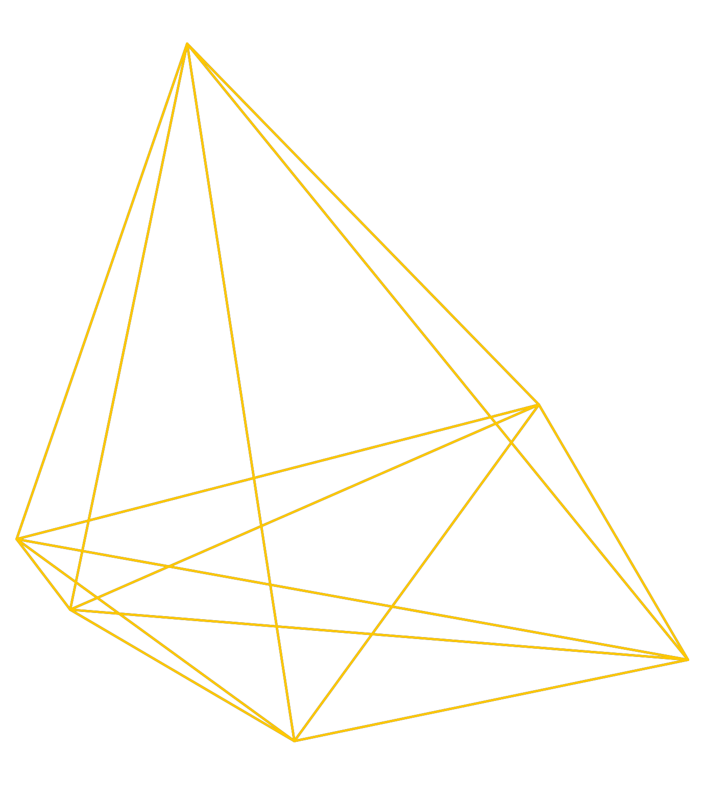
Libraries in a computational age
Chris Bourg, Director of MIT Libraries

Slide 2
About MIT
#1 university in world (QS ranking)
#3 university in US (US News)
1000 Faculty, ~12,000 students
5 schools

Slide 3
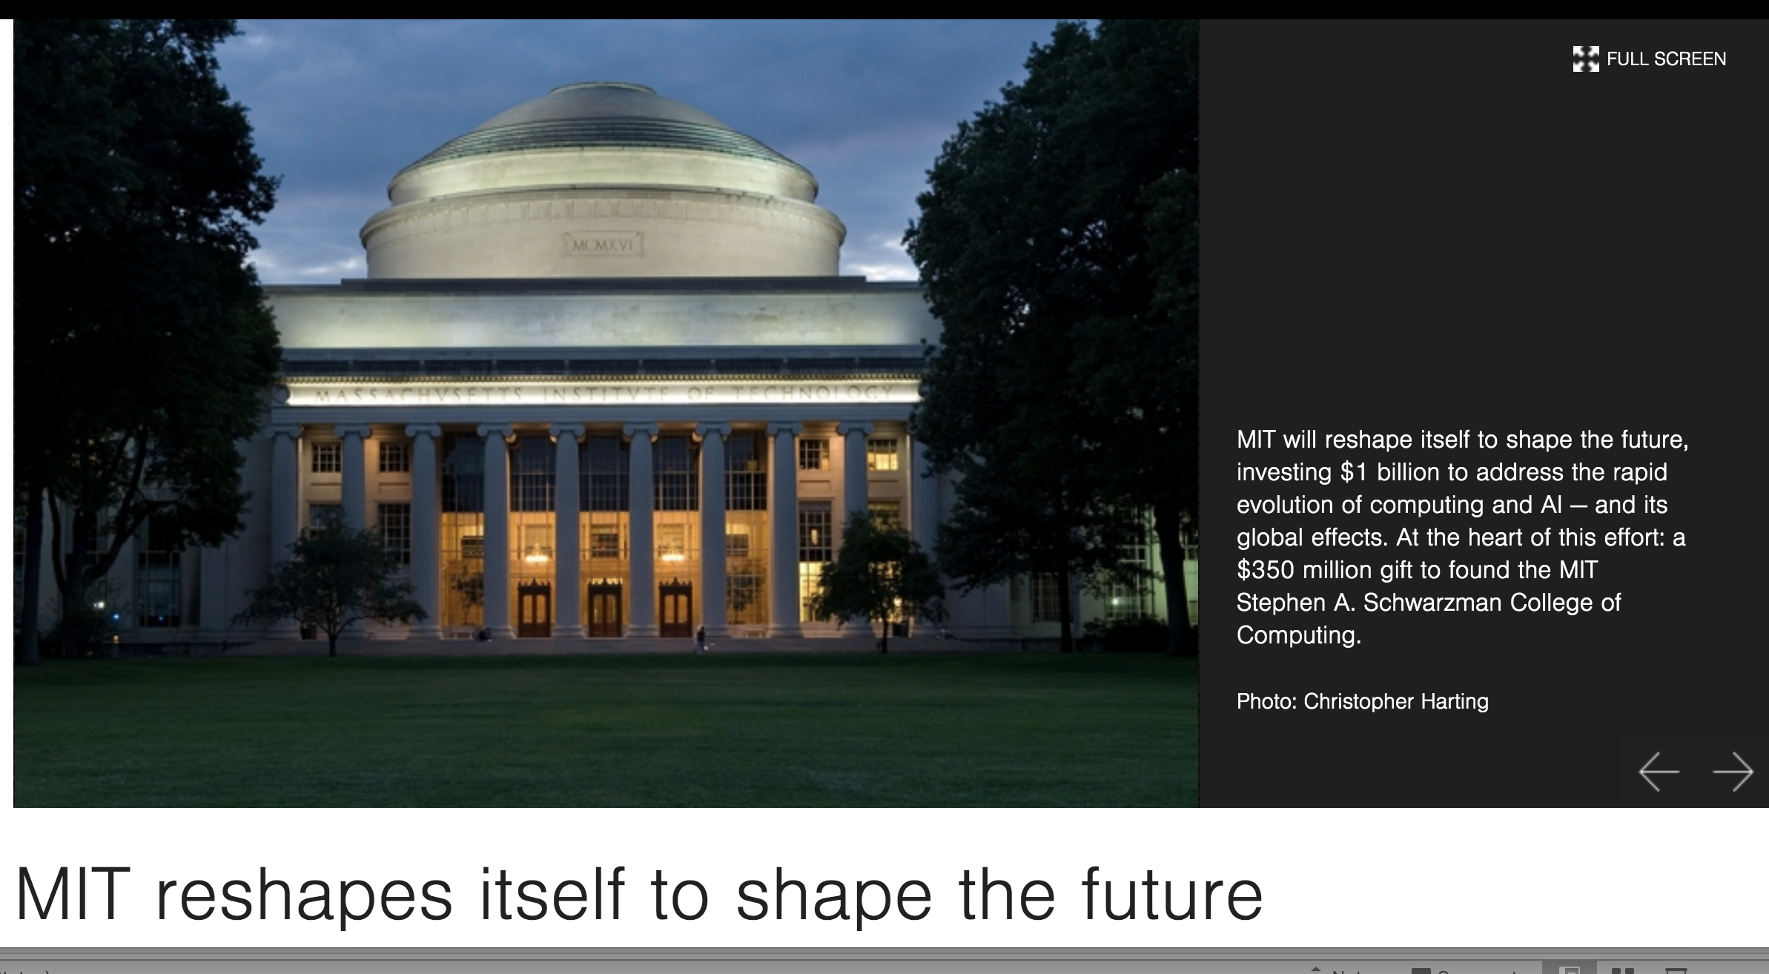
More about MIT
Mens et Manus
Commitment to open
New College of Computing

Slide 4
MIT Libraries
5 libraries, 160 staff
2.3 million physical items
> 30,000 open access articles
“small but mighty”

Slide 5
MIT Future of Libraries
30 member task force
Faculty, students, staff
Open forums, idea bank
Lots of discussions

Slide 6
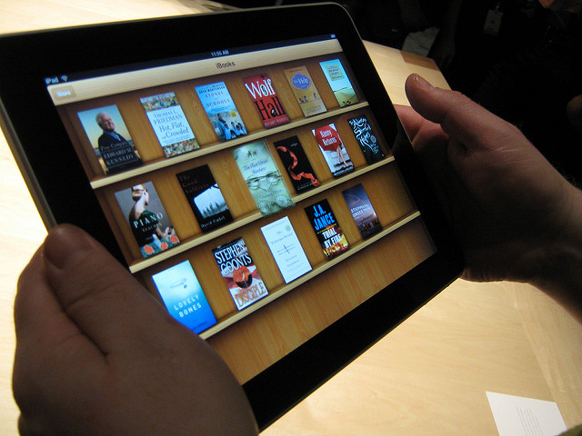
print …
…to digital

Slide 7
Evolution of research libraries
PLACE
SERVICE
Physical
PLATFORM
Physical
Digital
Physical
Digital
Computational
Restricted, static
Open, dynamic

Slide 8
“The MIT Libraries must operate as an open, trusted, durable, interdisciplinary, interoperable content platform that provides a foundation for the entire life cycle of information for collaborative global research and education.”
Future of Libraries TF, 2016
future-of-libraries.mit.edu

Slide 9
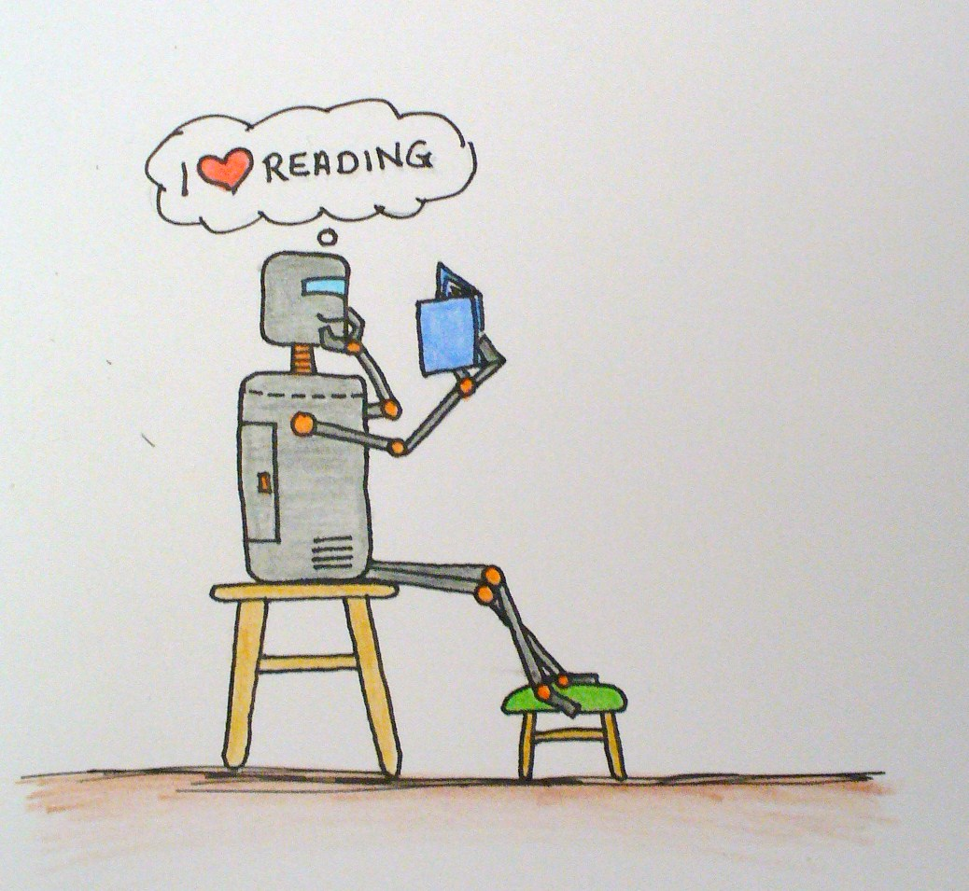
“…a repository of knowledge and data that can be exploited and analyzed by humans, machines, and algorithms...”

Slide 10
Open, interactive & computational
Open
not just about open access
library as place for open exchange of ideas
Interactive
creation and consumption
active and mutual
Computational
accessible to machine learning and AI
programs + data that can extract patterns and perform tasks at scale

Slide 11
Libraries in computational age
Address bias and ethics issue
Leverage AI/ML in our own work
Access to tools, training, resources
Access to data & collections

Slide 12
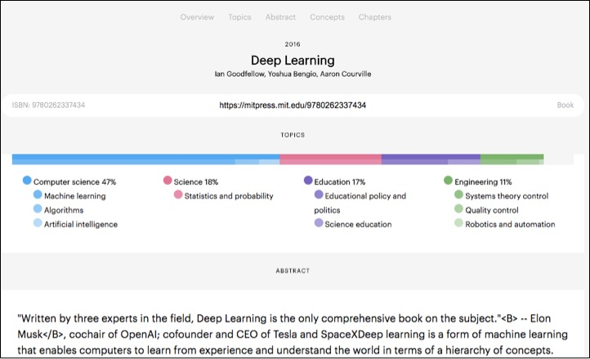

Slide 13
Libraries in computational age
Address bias and ethics issue
Leverage AI/ML in our own work
Access to tools, training, resources
Access to data & collections

Slide 14
open + computational = unprecedented scientific progress

Slide 15
“Open access to the products of teaching and research promises to speed the accumulation of knowledge and insight and enhance opportunities for collaboration.”
open-access.mit.edu

Slide 16
open + computational + academy-owned =
the right future

